Slide 1
COMP 2000
Week 7 - Wednesday

Slide 2
Last time
What did we talk about last time?
More recursion

Slide 3
Questions?

Slide 4
Project 2

Slide 5
Debugging

Slide 6
Debugging with print statements
When the output of your program isn't enough to tell you what the problem is, people sometimes use print statements
By injecting print statements at key locations, you can see
If certain points in your code are reached
What the values of variables are
Debugging with print statements can be useful and is nearly always available
There are even libraries that allow you to turn off the statements when you're no longer debugging

Slide 7
Debugging with an IDE
In modern times, there are more powerful (and easy to use) tools
Most modern IDEs, including Eclipse, have tools for debugging code
You can:
Set a breakpoint (where execution will pause)
Step over lines of code
Step into methods
Examine the values of variables
Much more!

Slide 8
Set a breakpoint
Programs run at blinding speed, so you have to pause them to get information
Setting a breakpoint is done in most debugging systems so that you can make the program pause where you want
In Eclipse, the easiest way to do this is to double-click on the narrow column just left of the line numbers
Doing so will create a breakpoint, shown with a blue dot
You can also choose Toggle Breakpoint from the Run menu

Slide 9
Debug mode
After you set one or more breakpoints and run your program…
Nothing changes!
In order for execution to pause at breakpoints, you have to run the program in debug mode
In Eclipse this is done by clicking on the bug icon (instead of the green circle with the white triangle)
Or you can right click on the .java file you want to debug and choose Debug As… Java Application instead of Run As… Java Application
Debugging changes you over to the Debug Perspective, reorganizing Eclipse's panes slightly
You might get a message about that
Debug Run

Slide 10
Inspecting variables
Now that you've paused execution, you can look at the value of local and member variables
The Variables tab will show you the value of local variables
It will also give you this, which allows you to explore the object you're inside of
Note that tabs can be moved around in Eclipse, so it might not be where you expect it
If it's hidden, you can go under Window > Show View > Variables
If you hover over a variable in code that's in scope, it will also show you its value

Slide 11
Step Over
Are you stuck at the point of code where the breakpoint is?
No!
You can Step Over the next line of code, executing it
This option is listed in the Run menu, but you usually Step Over code over and over, so use the F6 hotkey
If the line of code you're Stepping Over is a method, it will call the method and return, not go into the method
Unless there's a breakpoint inside the method

Slide 12
Step Into
On the other hand, what if you want to step into a method and see what's going on there?
That's what Step Into is for
Step Into (hotkey F5) will go inside of a method call instead of stepping over it
Gotchas:
Sometimes there are multiple method calls in a single line: you'll step into the first (even if that's not what you wanted)
If the method is library code that your system doesn't have source code for, you won't be able to see anything

Slide 13
Step Return
Sometimes you've gone into a method and have seen what you need to see
Rather than using Step Over to get through all the code in the method, you can immediately return using Step Return (hotkey F7)
Note that these hotkeys might vary from OS to OS, but they're always listed in the Run menu

Slide 14
Resume
And if you're really tired of going through code line-by-line, you can Resume execution
The Resume command has hotkey F8
Execution will continue until you hit another breakpoint
You can also Terminate the program by selecting the Terminate option from the Run menu or hitting the little red square on the Console or on the ribbon

Slide 15
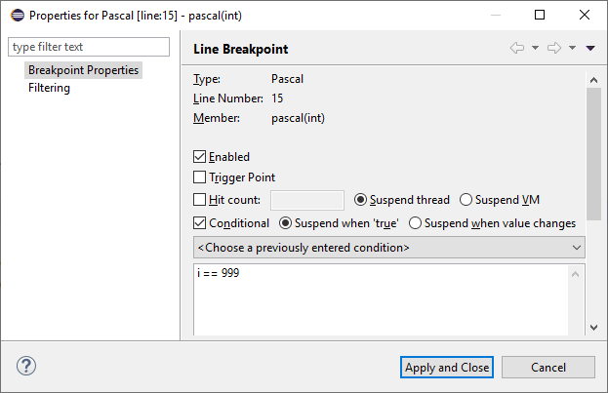
Conditional breakpoints
What if you want to figure out a problem in a loop…
But the problem happens after the loop runs 999 times
Well, it would be infuriating to try to Step Over or Resume code 999 times
Breakpoints can be conditional, meaning that they only pause code under certain circumstances
Simply right-click on the breakpoint and choose Breakpoint Properties…
You can add a condition or a hit count or other properties

Slide 16
Moving through the stack
Whether doing recursion or not, many methods might be on the stack
The currently executing line is only in one location
However, the whole stack is active
Using the Debug pane, you can jump around to different places on the stack and see what the values of local variables are

Slide 17
Strange stuff
Using the debugger, you can change variables as well as inspecting them
You shouldn't do that often, but it sometimes lets you test some weird case that's otherwise hard to achieve

Slide 18
Debugging example
Let's use the debugger on the following method that's supposed to reverse an array and see what the problems are
public void reverse(int[] array) {
for(int i = 1; i < array.length; ++i) {
int temp = array[i];
array[i] = array[array.length - i];
array[array.length - i] = temp;
}
}

Slide 19
Tower of Hanoi

Slide 20
Tower of Hanoi
The Tower of Hanoi is a mathematical puzzle invented by the mathematician Édouard Lucas in the 19th century
It is a board with three rods
On the first rod sits a stack of n disks in increasing order of size, with the smallest disk on the top
The goal is to move all of the disks to the third rod
There are three rules:
You can only move one disk at once
Each move takes the top disk from one rod and puts it on the top of another (possibly empty) stack on another rod
No larger disk may be placed on top of a smaller disk

Slide 21
Solving Tower of Hanoi
Professor Stucki has a wooden set you can play with
It's fun to move the disks around, but how can we come up with an algorithm that solves the problem?
Recursion!

Slide 22
Recursive solution
Base case (n = 1):
If there is only one disk, move it to its destination
Recursive case (n > 1):
First move n – 1 disks to a temporary pole
Then move the n^{th} disk to the destination
Then move n – 1 disks from the temporary pole to the destination

Slide 23
Tower of Hanoi code
public static void hanoi(int n, char from, char to, char temp) {
if( n == 1 )
System.out.println("Move disk from " + from +
" to " + to);
else {
hanoi(n – 1, from, temp, to);
hanoi(1, from, to, temp);
hanoi(n – 1, temp, to, from);
}
}
Base Case
Recursive
Case

Slide 24
Lessons from Tower of Hanoi
The recursion is pretty interesting
You can prove that there's no faster way to do it than the given approach
But it's very slow!
100 disks would take longer than the Universe has been in existence, even on the faster modern computers
How can we understand how long recursion takes?
Take COMP 2100 and COMP 4500 to find out!

Slide 25
Quiz

Slide 26
Upcoming

Slide 27
Next time…
n queens
Mergesort

Slide 28
Reminders
Keep reading Chapter 19
Finish Project 2
Due Friday

